Slide 1

Green Pace
Security Policy Presentation
Developer: Michael Iyaomolere
Multi-factor Authentication

Slide 2

OVERVIEW: DEFENSE IN DEPTH
Multi-factor Authentication. This adds an extra layer of security to avoid hacking of systems.

Slide 3
THREATS MATRIX
Likely Loss of Confidentiality | Priority Loss of Availability
Low priority Inadequate exception Handling | Unlikely Loss of Integrity

Slide 4
10 PRINCIPLES
Validate Input Data - Obey the one-definition rule
Heed Compiler Warnings - Do not cast to an out-of-range enumeration value
Architect and Design for Security Policies - Do not attempt to create a std::string from a null pointer
Keep It Simple - Be careful using functions that use file names for identification
Default Deny - Use a static assertion to test the value of a constant expression
Adhere to the Principle of Least Privilege
Sanitize Data Sent to Other Systems
Practice Defense in Depth
Use Effective Quality Assurance Techniques
Adopt a Secure Coding Standard - Handle all exceptions

Slide 5
CODING STANDARDS
Data Type - Obey the one-definition rule
Data Value - Do not cast to an out-of-range enumeration value
String Correctness - Do not attempt to create a std::string from a null pointer
SQL Injection
Memory Protection - Do not call a deallocation function on anything other than nullptr
Assertions - Use a static assertion to test the value of a constant expression
Exceptions - Handle all exceptions
Input Output - Be careful using functions that use file names for identification
Concurrency - Do not destroy a mutex while it is locked
Containers - Use valid iterator ranges

Slide 6
ENCRYPTION POLICIES
Encryption in rest - Encryption at rest is designed to prevent the attacker from accessing the unencrypted data by ensuring the data is encrypted when on disk.
Encryption at flight - The process of encrypting data while the data is being transmitted. In some applications, such as remote replication, data may be unencrypted while it is at rest on drive arrays, but encrypted while it is being transmitted to provide protection.
Encryption in use - In-Use encryption takes a new approach that ensures that sensitive data is never left unsecured, regardless of or lifecycle stage (at rest, in transit, or in use) source, or location (on premise, cloud, or hybrid).

Slide 7
TRIPLE-A POLICIES
Authentication - Authentication is the act of validating that user are whom they claim to be. This is the first step in any security process.
Authorization - Authorization in system security is the process of giving the user permission to access a specific resource or function. This term is often used interchangeably with access control or client privilege.
Accounting - Accounting is the process of taking into consideration all things are require in the implementation of a secure application.

Slide 8
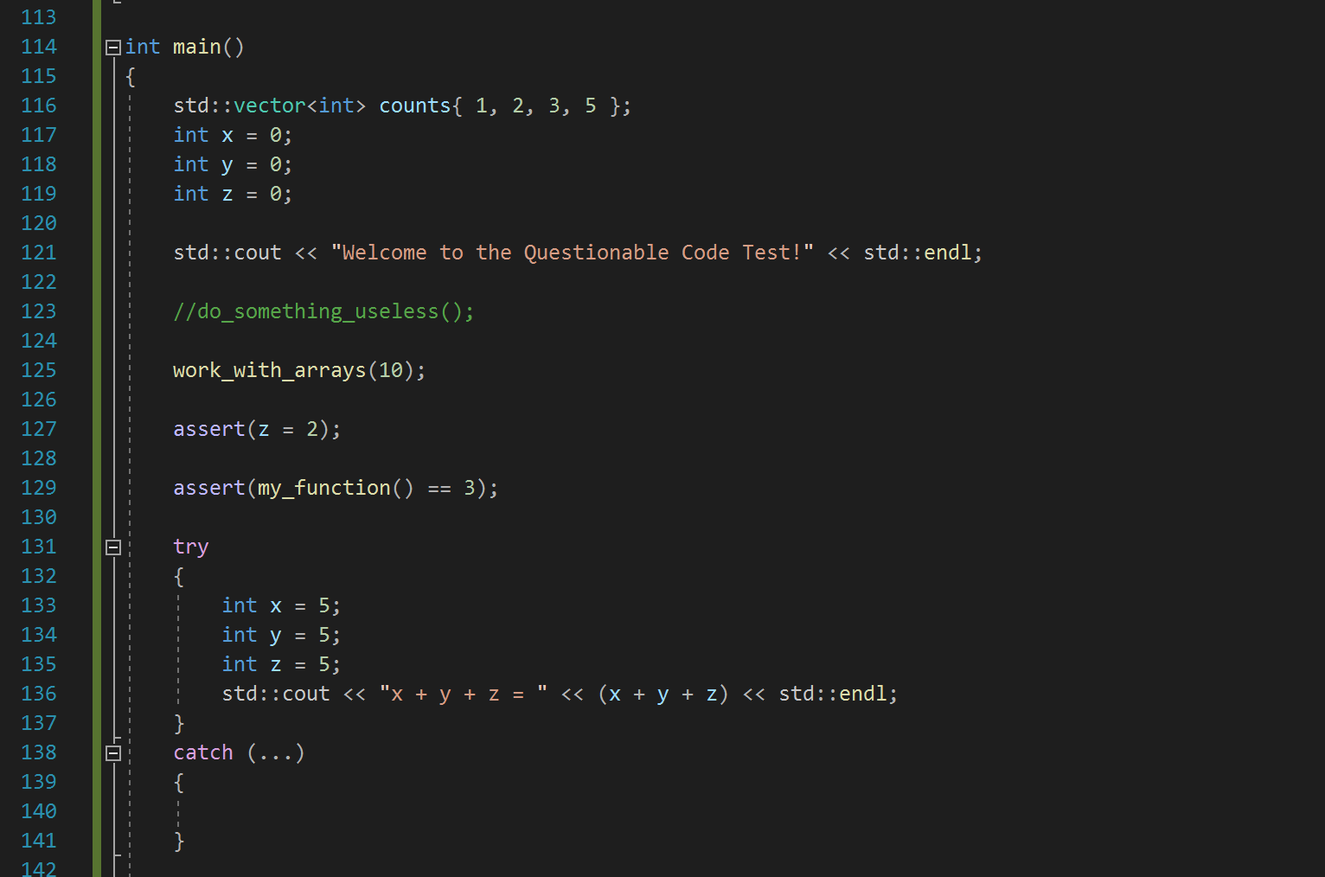
Unit Testing

Slide 9

AUTOMATION SUMMARY

Slide 10
TOOLS
DevSecOps refers to integrating security into your software development life cycle.
A DAST tool “looks inside” an application and dynamically analyzes execution logic and live data. In addition, these types of tools provide DevSecOps pipelines with the following benefits:
Analyzes the whole application as it runs, within the full system environment.
Attempts to break encryption algorithms from outside.
Verifies permissions to ensure the isolation of privilege levels.

Slide 11
RISKS AND BENEFITS
The problem is enhancing the loop holes and gaps in a software security infrastructure
The solution is to implement all the securities and policies to safeguard the application.
The risk involved is exposure to hackers and the benefit is a secure software.

Slide 12
RECOMMENDATIONS
Gaps:
Unpreparedness
Unknown threats
Is it too late?
Lack of monitoring
Incident handling
People risk
Recommendations
Threat Modeling
Scan
Analyze
Remediate
Monitor

Slide 13
CONCLUSIONS
The coding standards and security policies should be adopted to prevent future problems.

Slide 14
REFERENCES
https://www.perforce.com/blog/kw/devsecops-pipeline-overview
https://www.chubb.com/au-en/businesses/resources/10-common-gaps-in-cyber-security.html

